Slide 1
Manufacturing Technology Norwegian Catapult Centre
Will develop and demonstrate innovative production processes and enabling technologies in mini factories, in cooperation with industry, research- and education institutions.
Will be a driving force in stimulating the Norwegian manufacturing industry to become:
Greener
Smarter
More innovative
More productive

Slide 2
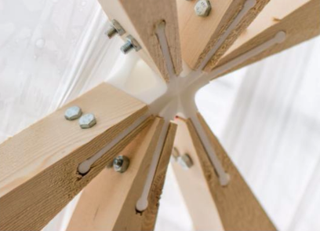
Enabling technologies in the NMTC
Manufacturing processes
Production processes for aluminium and plastic/composite
Multi-material joining and hybrid structures
Additive manufacturing
Digitalization and Industry 4.0
Sensor-based robotics and flexible automation
Cyber-physical systems
Mathematical modelling, simulation and optimization
Human-machine interaction
Information security

Slide 3
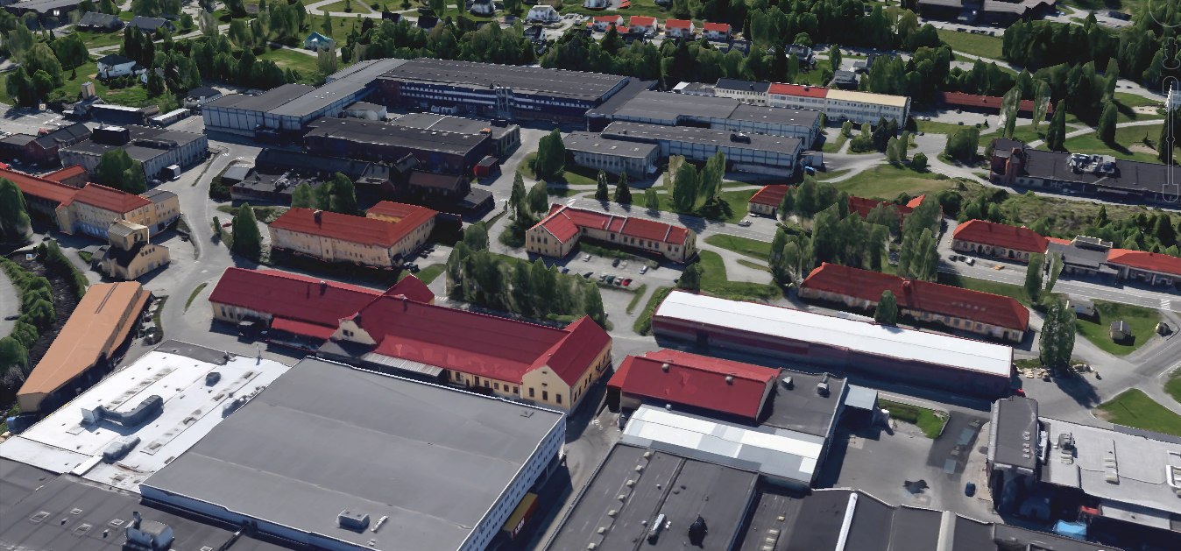
NMTC will be closely integrated with NCE Raufoss
500 m2 service- and conference center opening 5.2.2018
1000 m2 industry course VGS
500 m2 industry museum
B100
B18
B5
B20
B9
6500 m2 mini factories
Incl industry lab for TIP, TAF, FI, NTNU and EVU
B14
B15
B297
B273

Slide 4
3 axis and 3 levels
User axis
Level 1, 2 and 3
Knowledge axis
Technology and industrial production at VGS
Technology and industrial production at Fagskolen
NTNU industry-oriented education
Expert teams as a central way of working
Infrastructure axis
10000 m2 with an own service center available to all
Global equipment and software suppliers

Slide 5
User axis
Level 3
Local and regional industrial networks and companies across Norway with little research-intensity within specific enabling technologies
Level 2
Level 1
Strategically important and research-intensive organization within and outside the search environment
Research-intensive organizations
System integrators
Software suppliers
Regional industrial and research networks
Participants in strategic decisions
Participants in strategic decisions

Slide 6
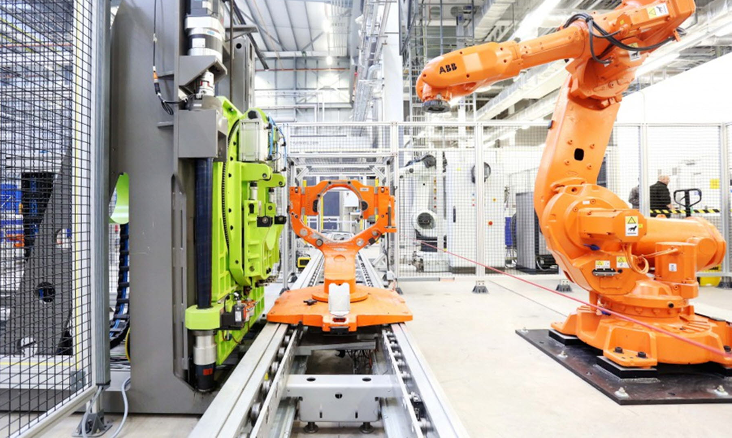
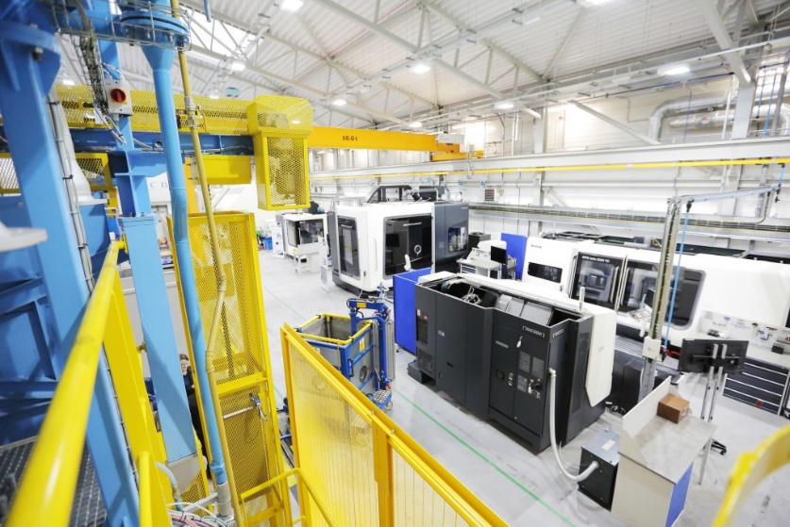
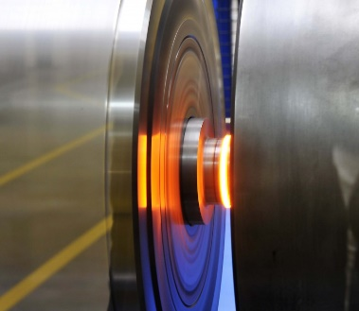
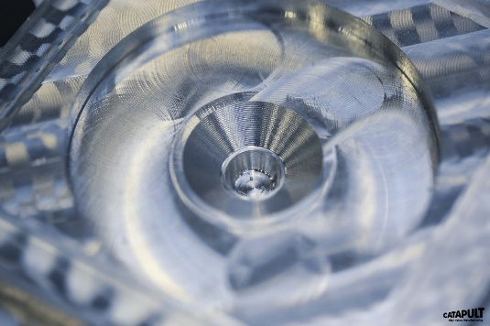
World-class factory standard
Photo's: Catapult – High Value Manufacturing, UK

Slide 7
4 to 6 KFS mini factories
Illustration: University in Darmstadt, Germany

Slide 8
NMTC digital compass
Network
Publications
Meeting points
Standardization
Meaning of Industry 4.0
Implementation & collaboration
Information
Professional advice
NMTC i4.0 compass
Information and help
Testing
Orientation
Financing opportunities
Good examples
Test facilities
Demonstration & qualification
Readiness check
Demo & test lab tours
Workshops & training
Source: Platform Industry 4.0, Germany

Slide 9
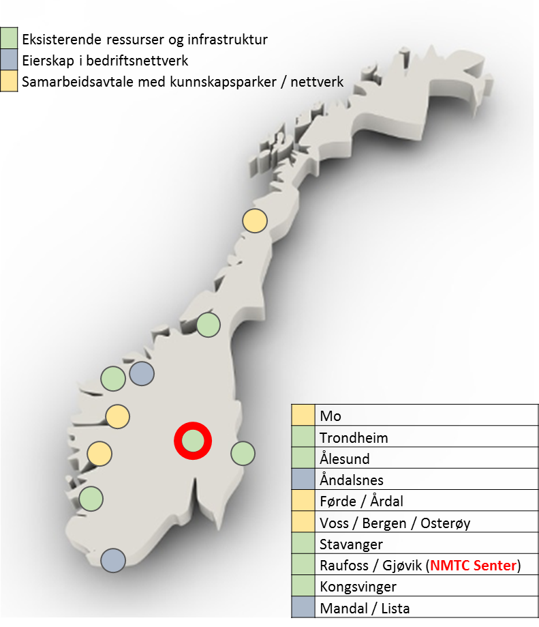
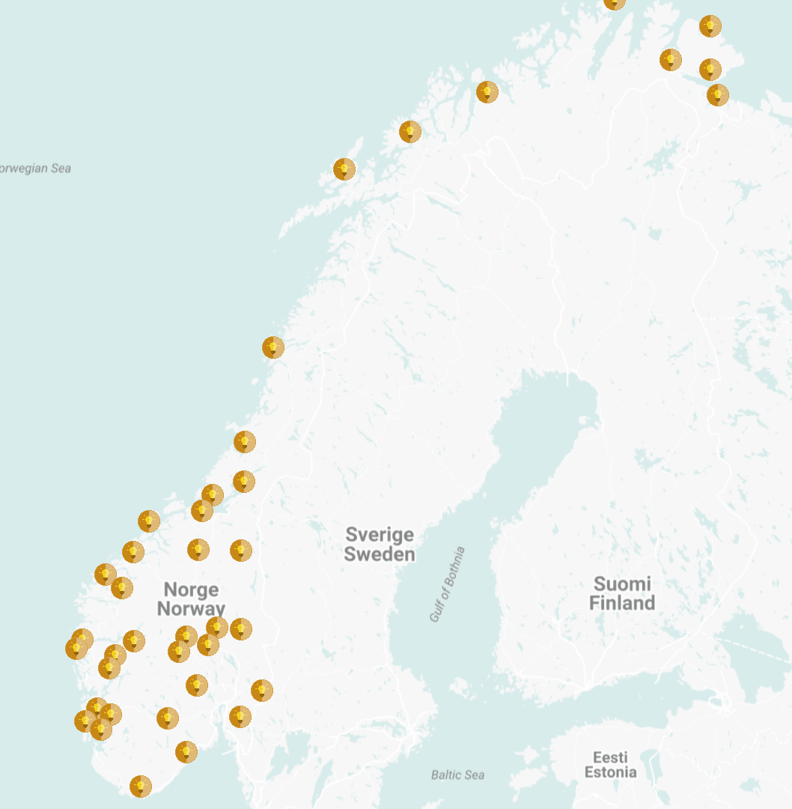
Regional nodes and business parks

Slide 10
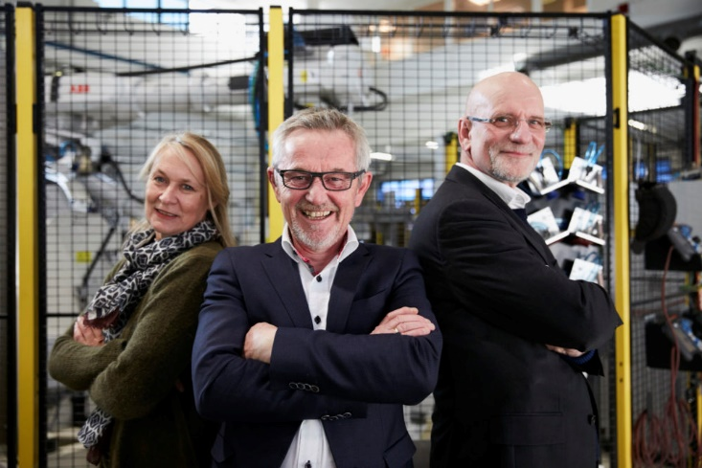
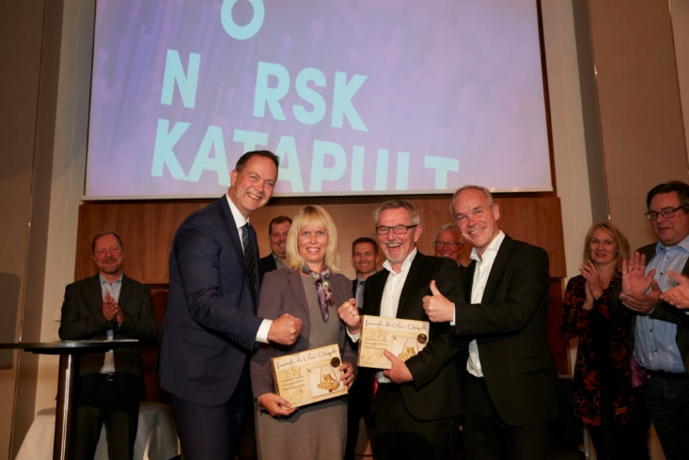
We are looking forward to getting started!
Photos: Jarle Nyttingnes, Siva

